Slide 1

CAMPUS GALLERY

Slide 2


Slide 3
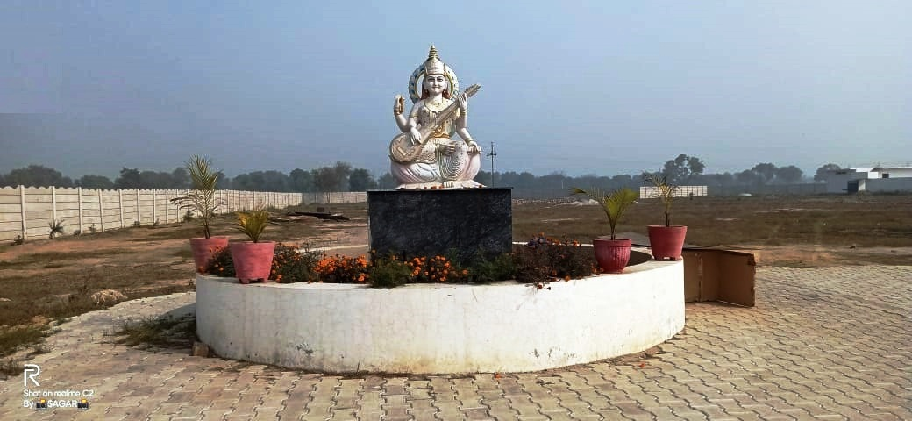
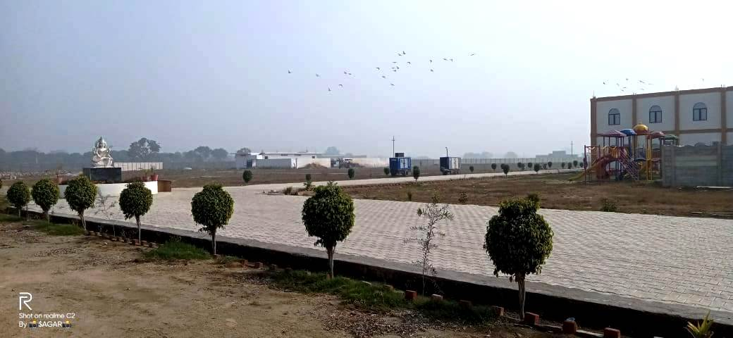

Slide 4
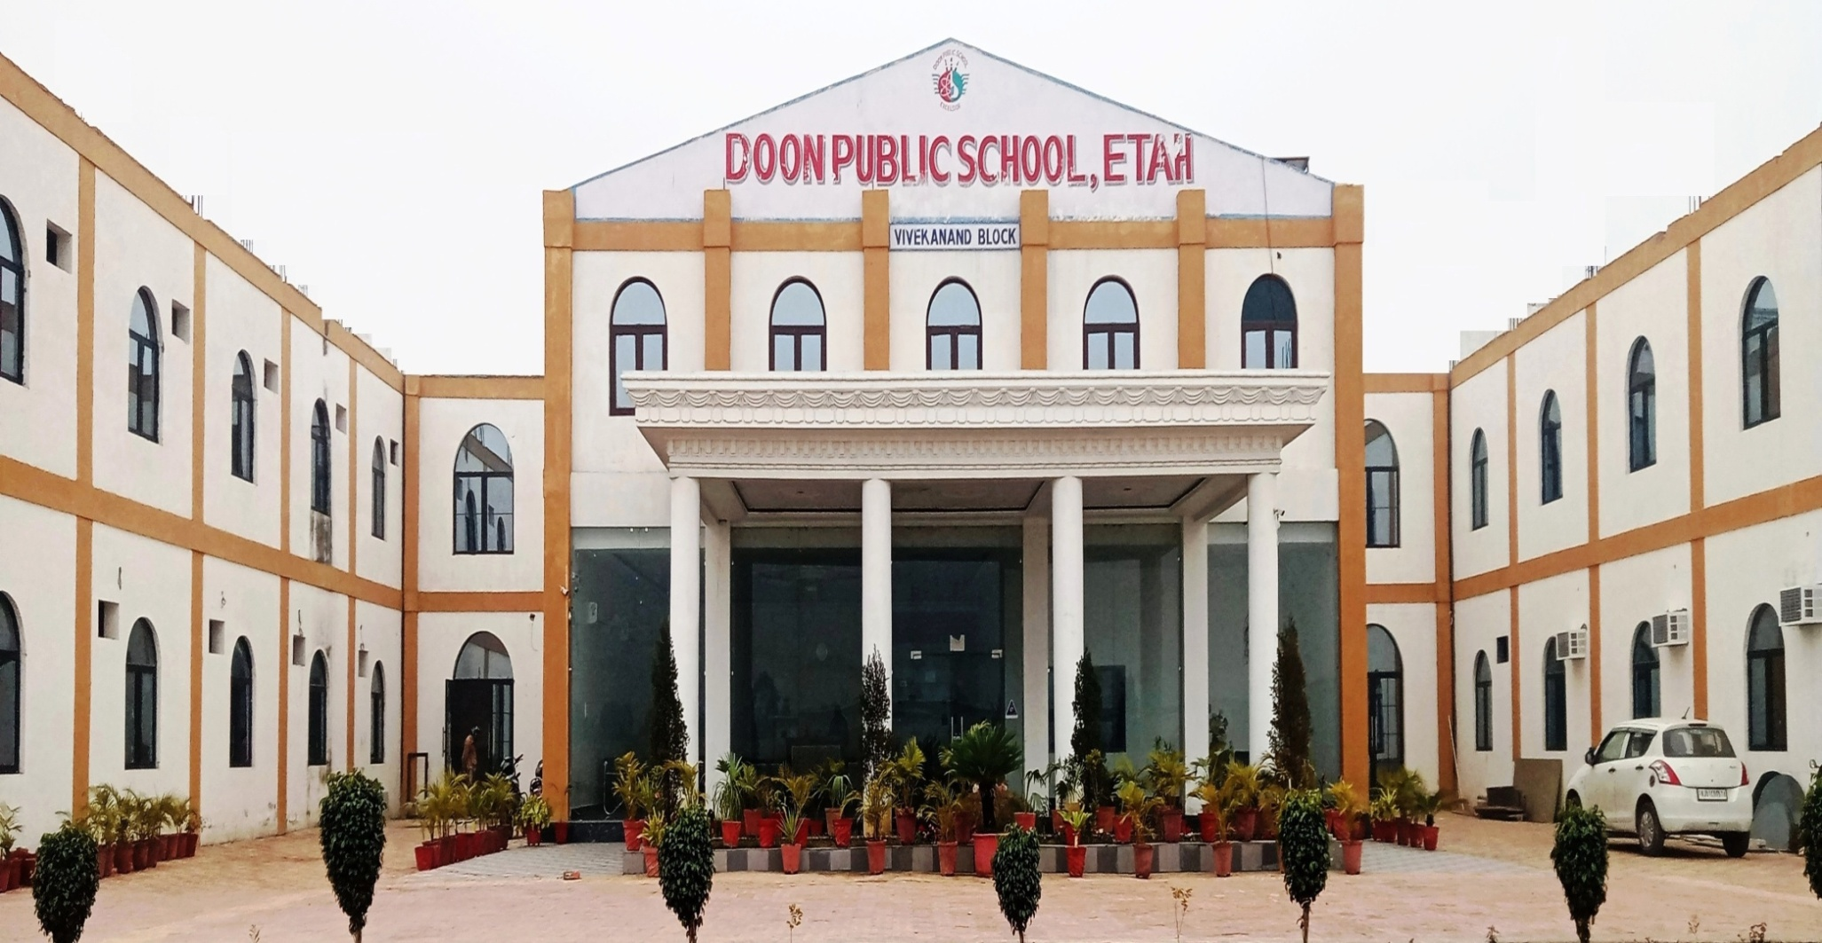
VIVEKANAND BLOCK

Slide 5
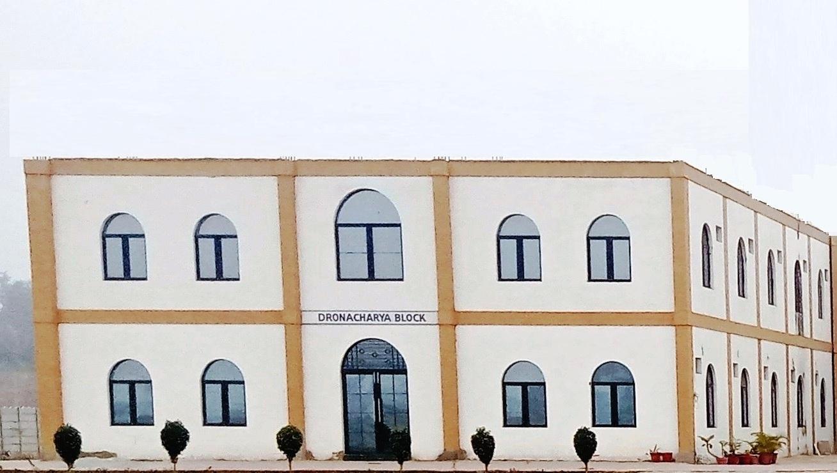
DRONACHARYA BLOCK

Slide 6
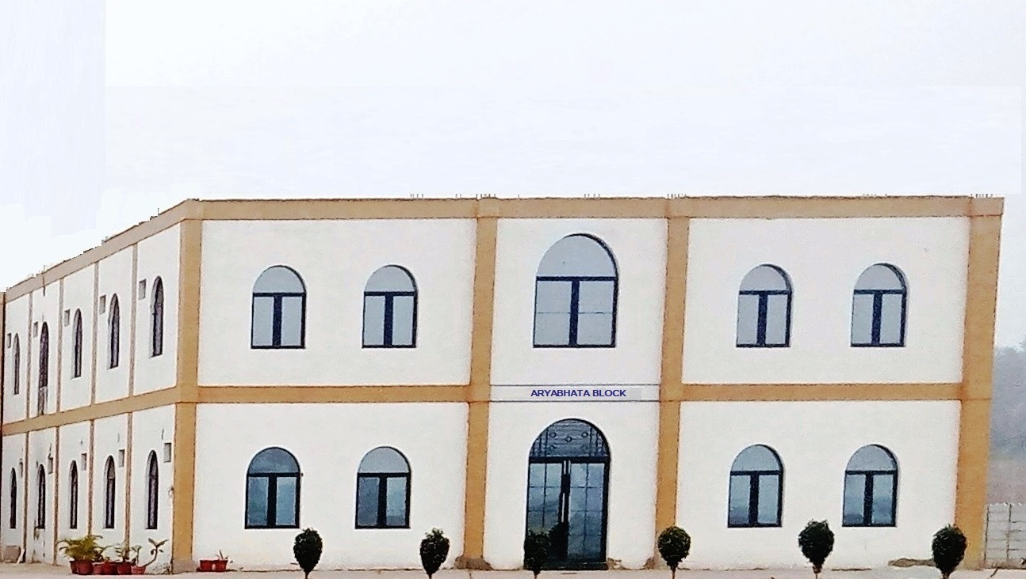
ARYABHATA BLOCK

Slide 7
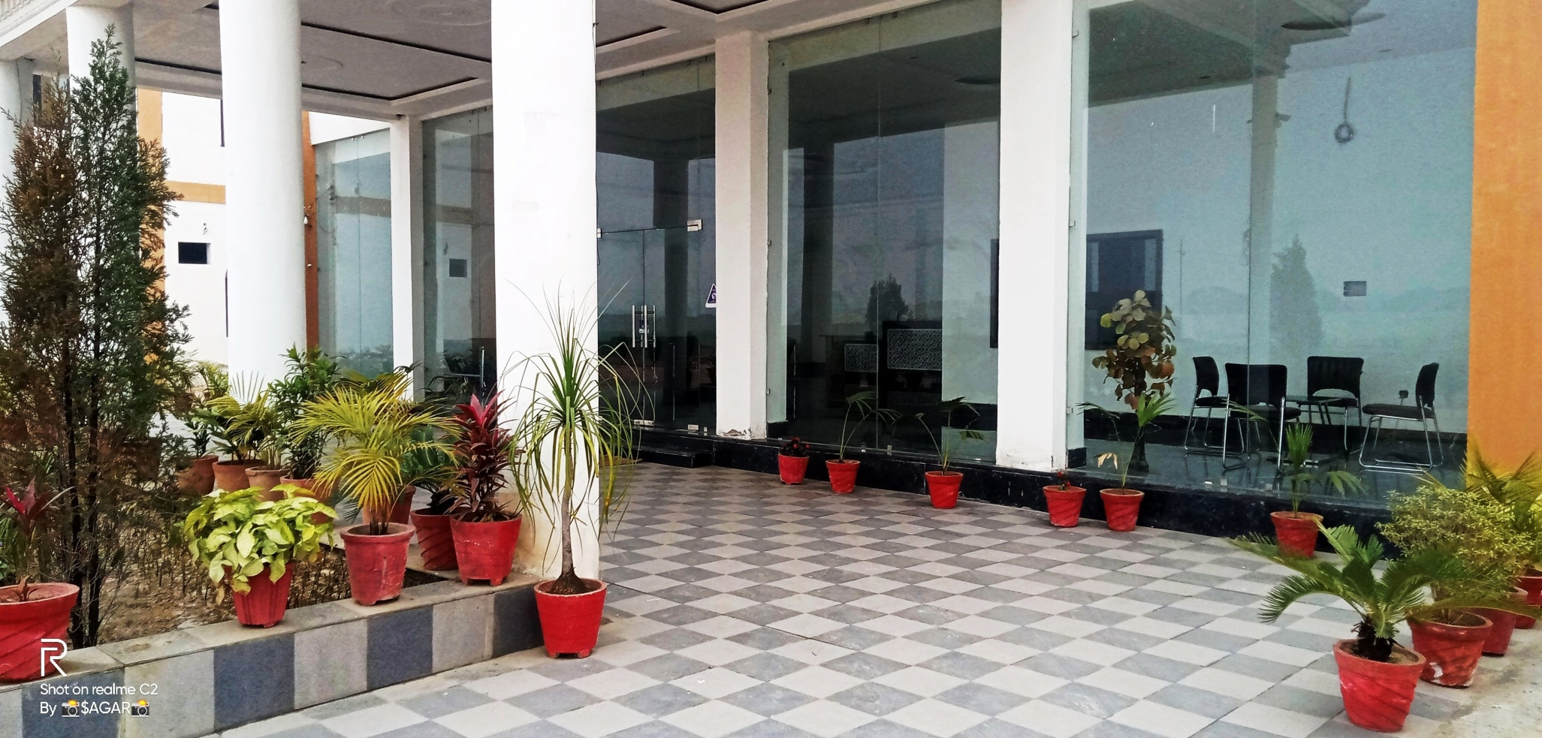
VENTURE ENTRANCE

Slide 8
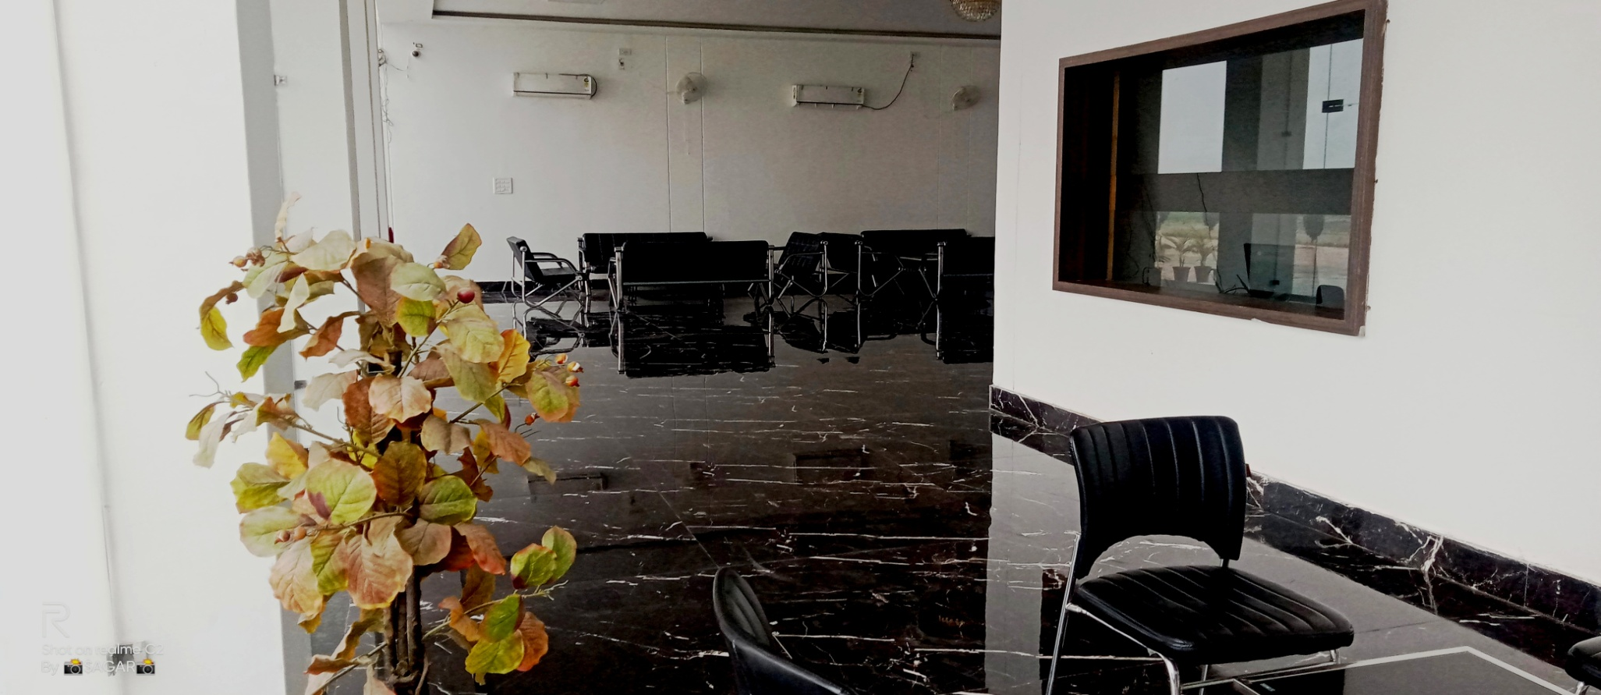
FEES WINDOW

Slide 9
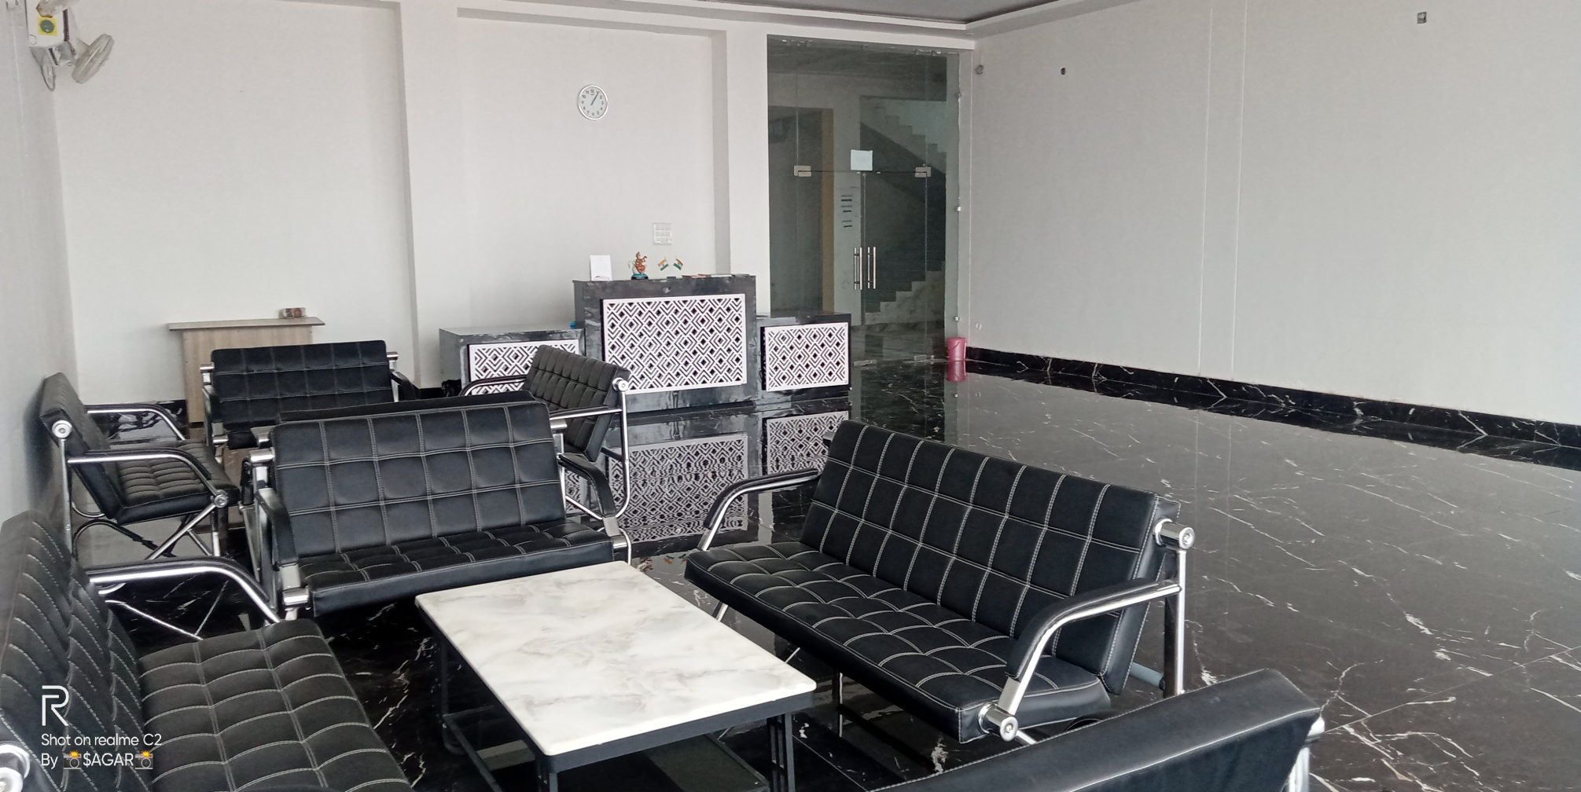
RECEPTION HALL

Slide 10
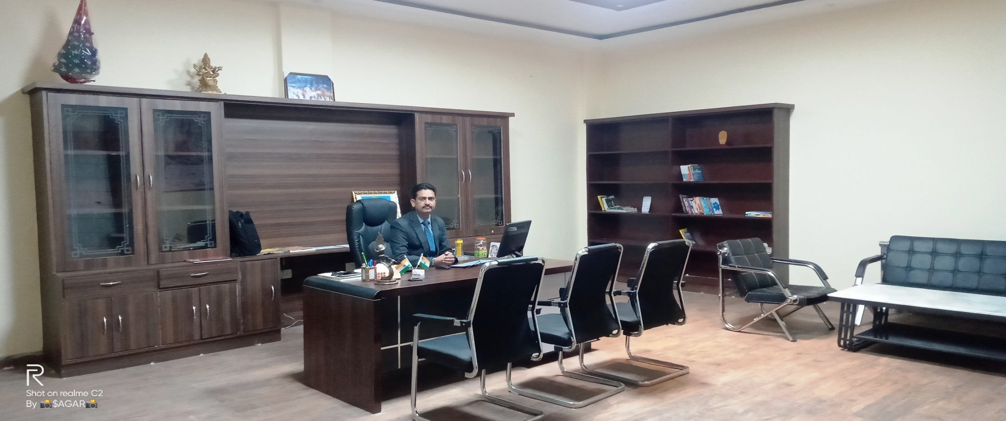
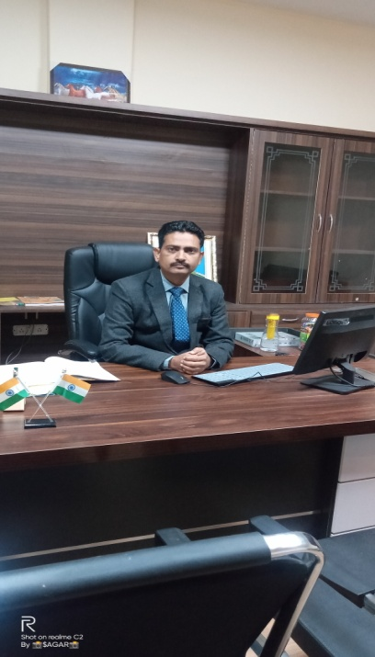
PRINCIPAL’S DESK

Slide 11
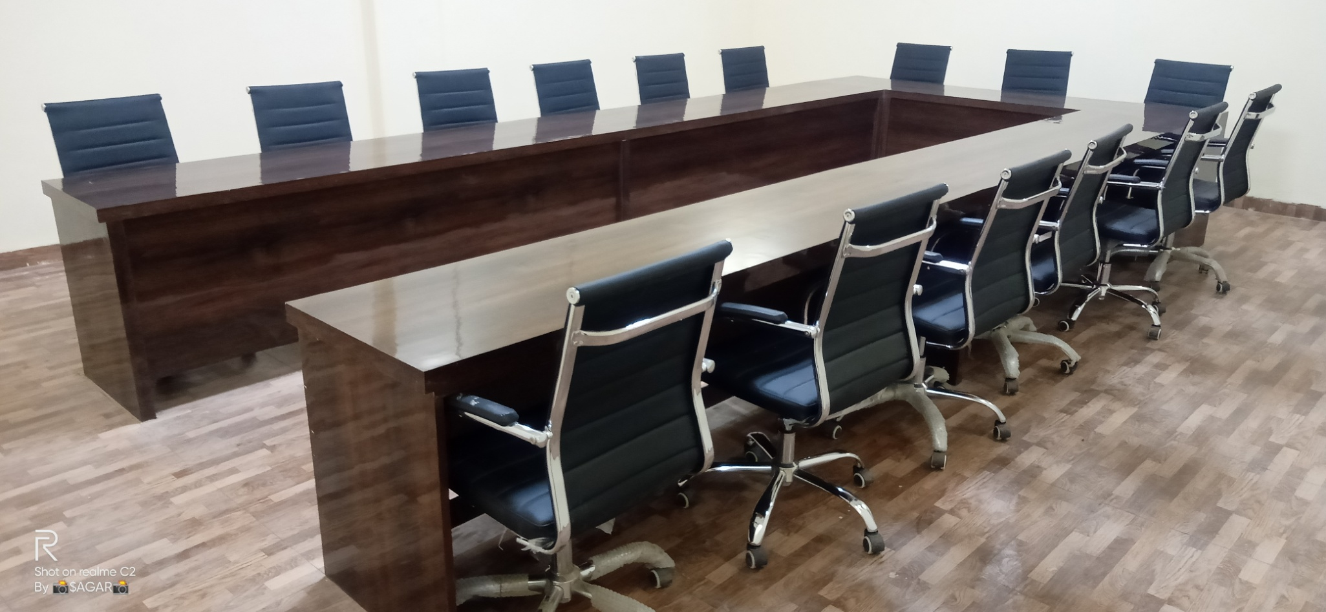
CONFERENCE ROOM

Slide 12
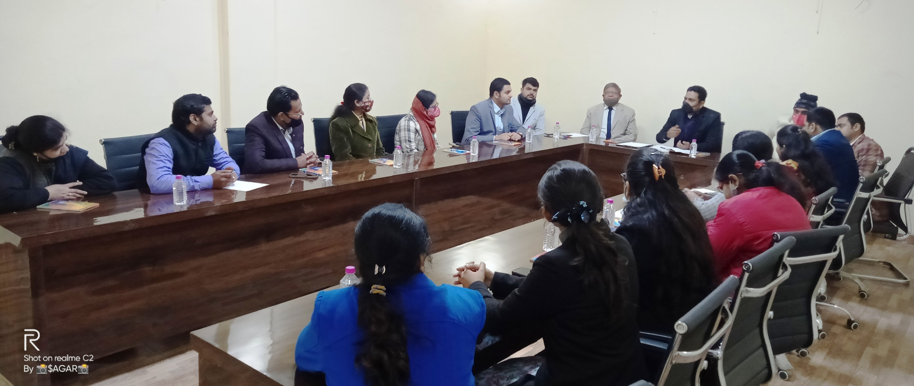
A brainstorming session

Slide 13
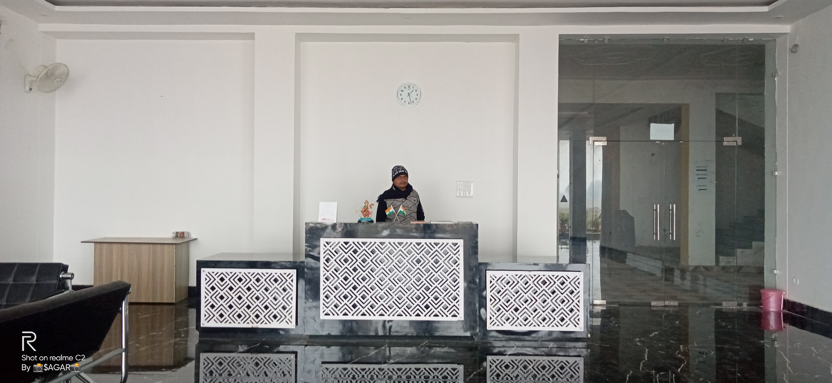
RECEPTION

Slide 14
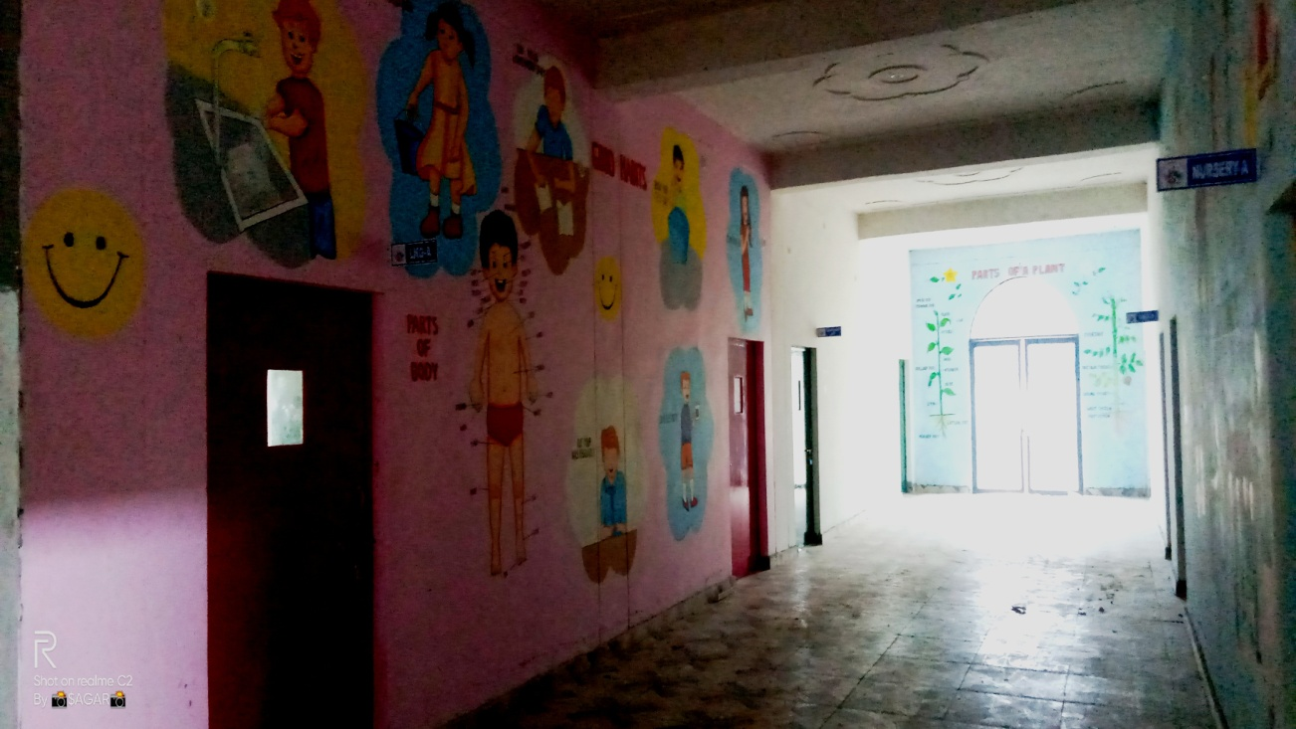
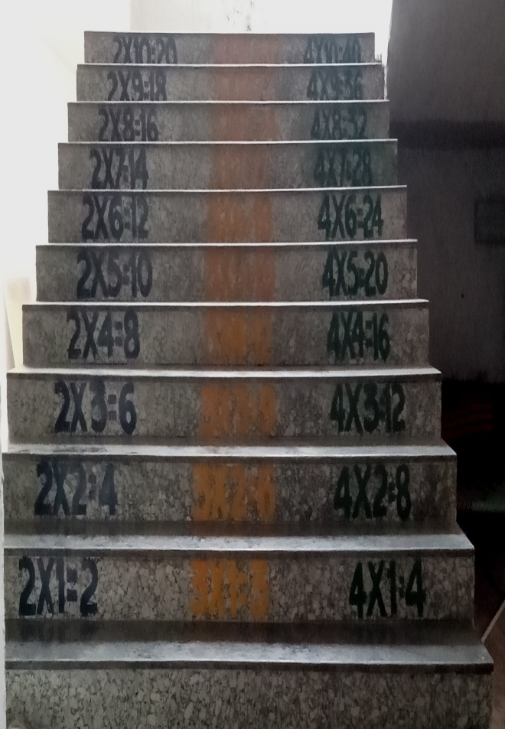
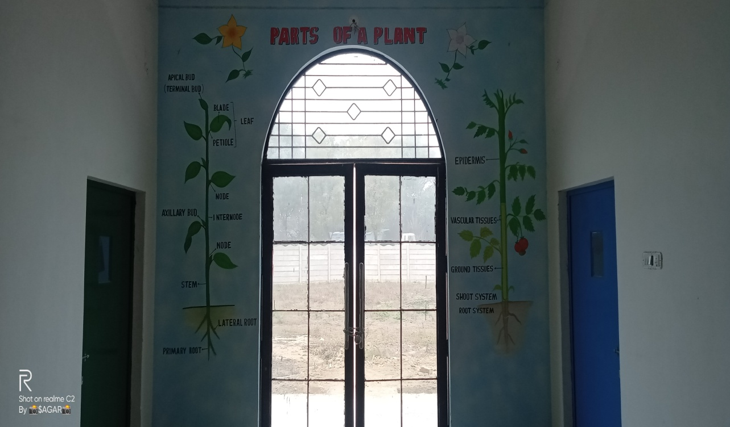
JUNIOR
CORRIDOR

Slide 15
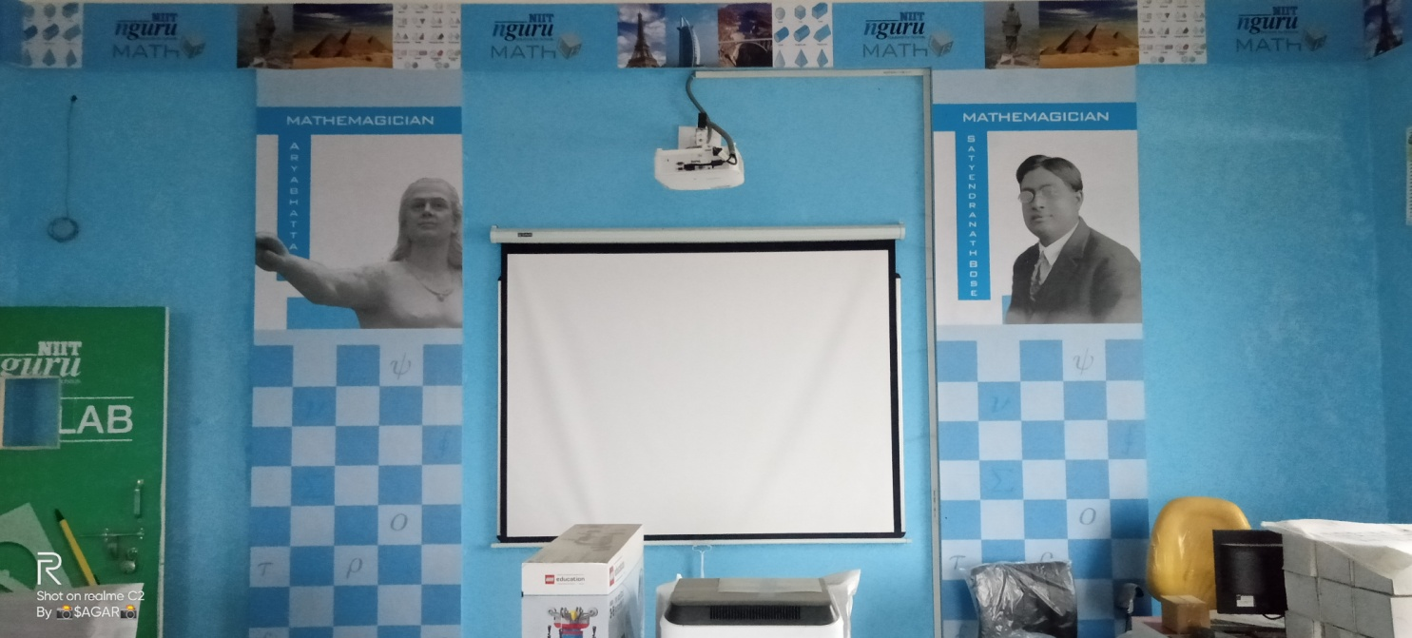
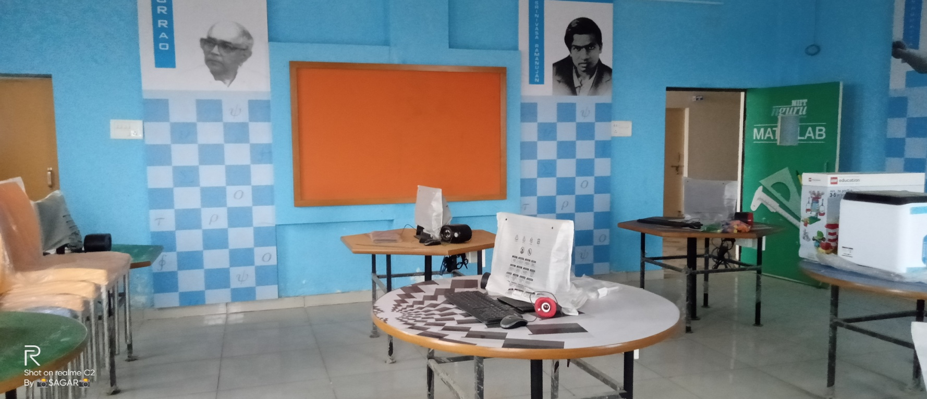
MATHS LAB BY NIIT

Slide 16
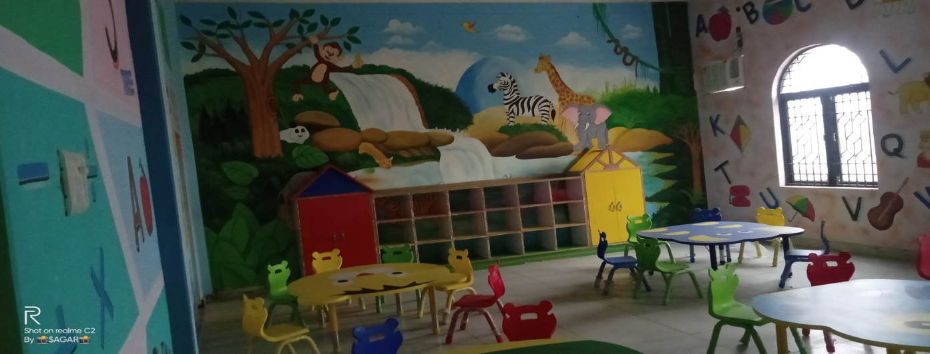
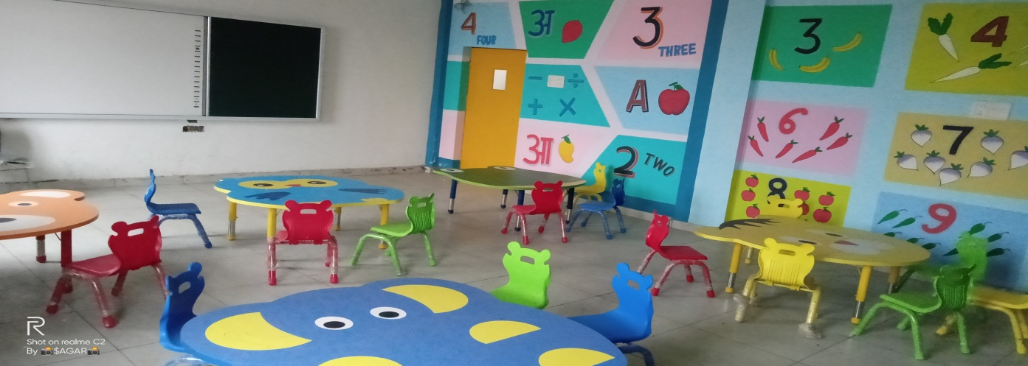
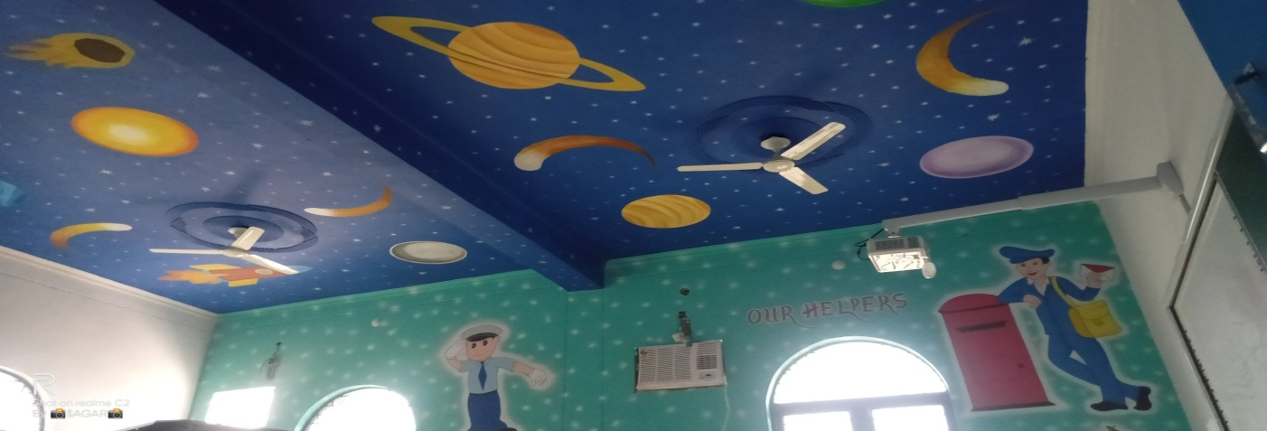
WELL
FURNISHED
SMART
CLASSROOM

Slide 17
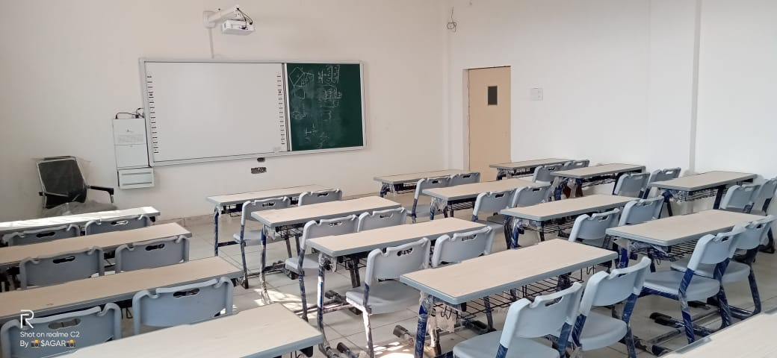
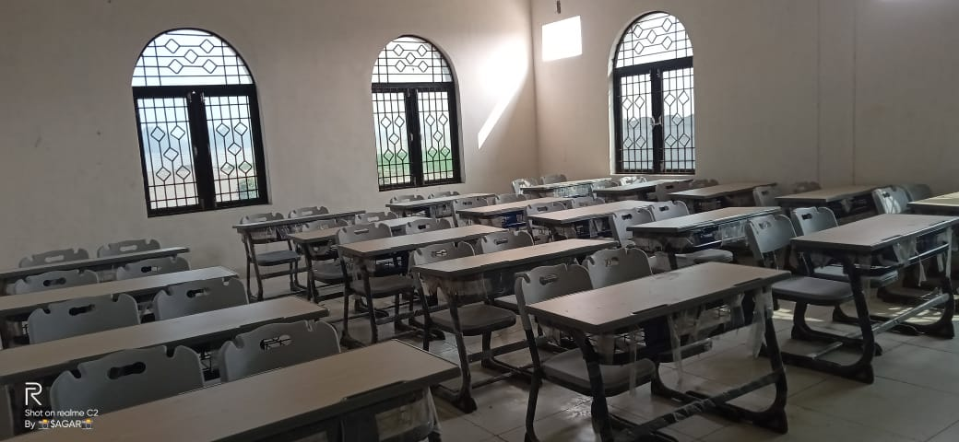
SMART
CLASSESS

Slide 18
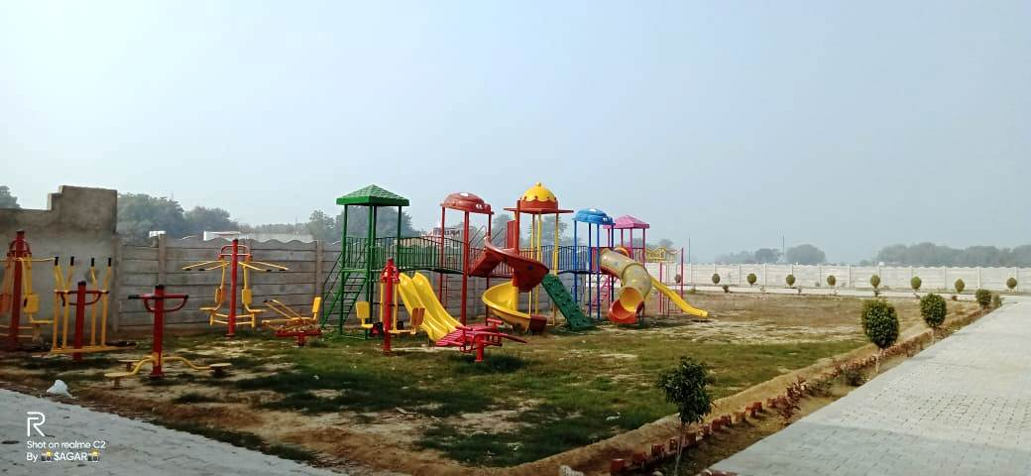
KINDERGARTEN

Slide 19
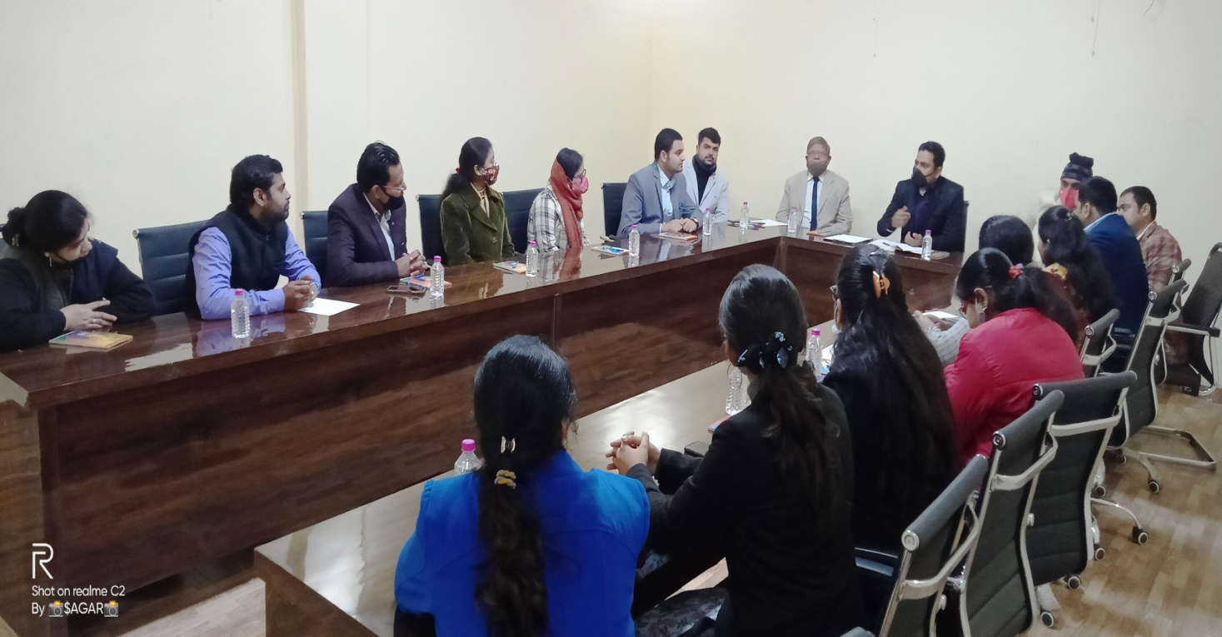
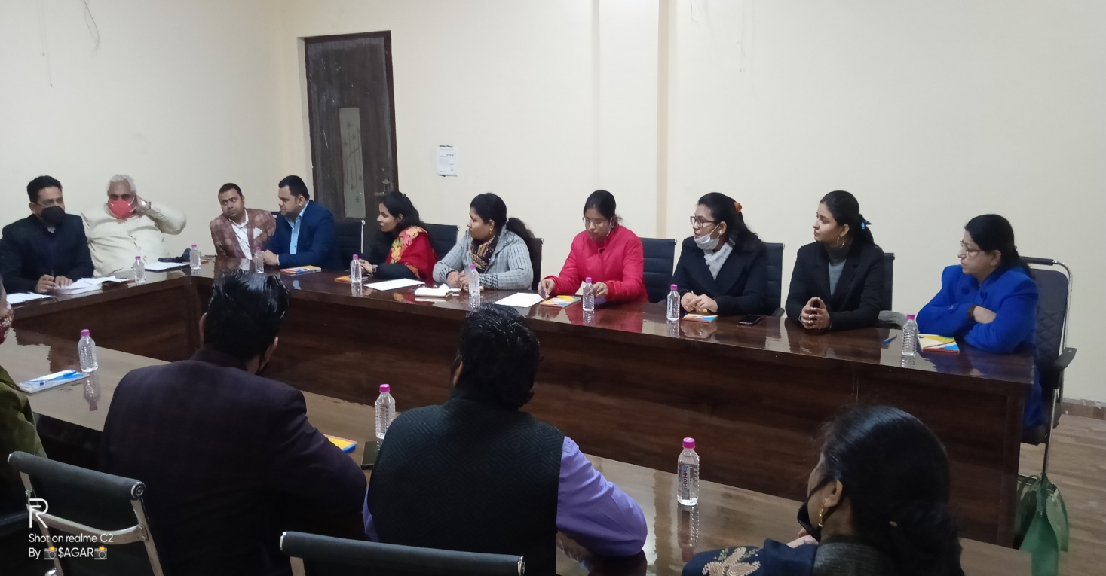
WELL EXPERIENCED
STAFF
#Supportive_Pillars

Slide 20
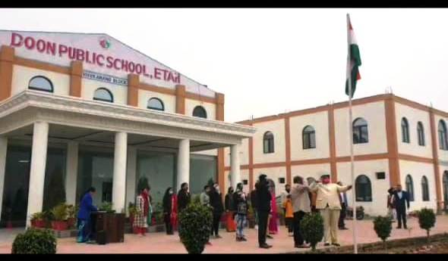
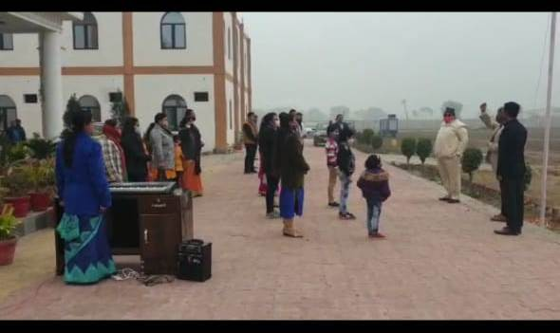
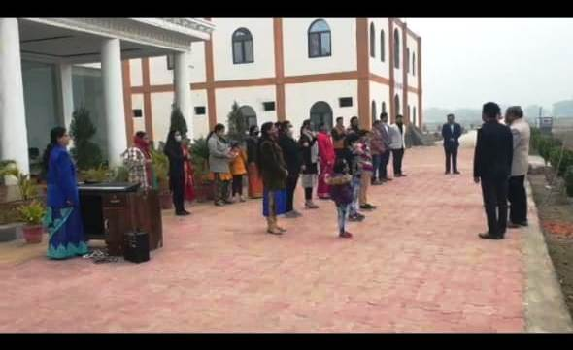
72th
REPUBLIC DAY
CELEBRATION

Slide 21
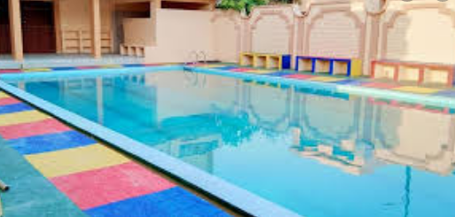
swimming Pool for all

Slide 22

200 m. Athletics track

Slide 23

Football ground

Slide 24

Volley-ball

Slide 25
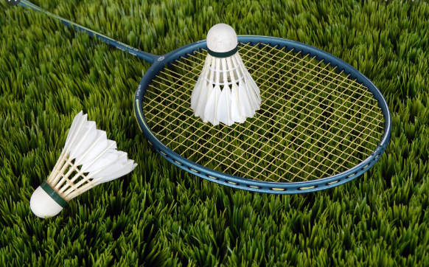
badminton

Slide 26

BASKET BALL

Slide 27
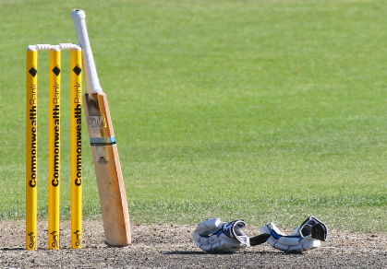
cricket

Slide 28
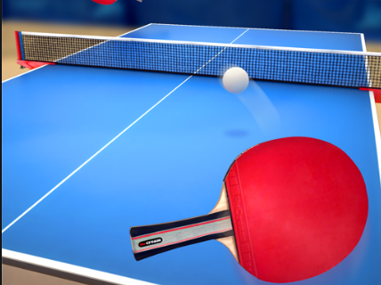
TABLE TENNIS

Slide 29
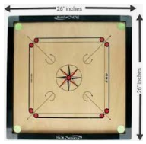

INDOOR GAMES

Slide 30
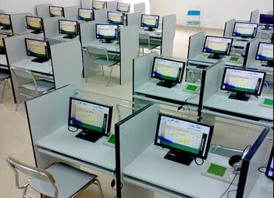
Digital language lab

Slide 31
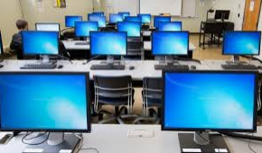
COMPUTER LAB

Slide 32
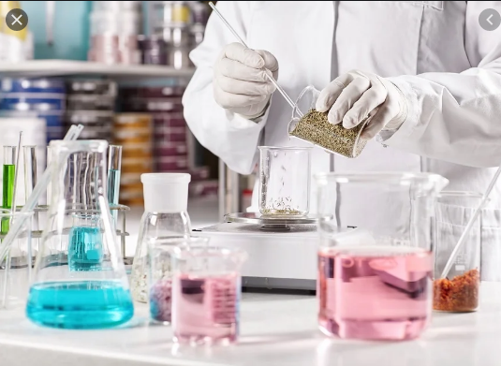
CHEMISTRY LAB

Slide 33
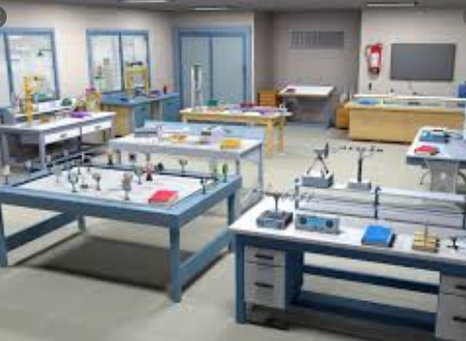
PHYSICS LAB

Slide 34
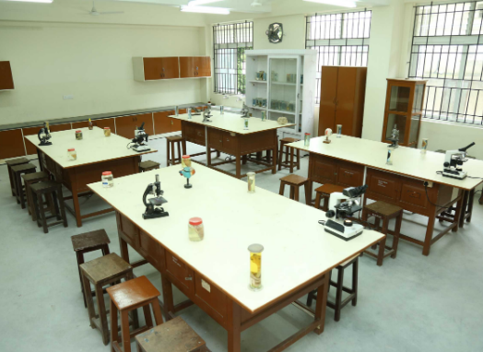
BIOLOGY LAB

Slide 35
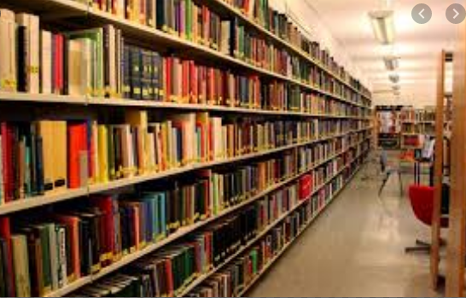
LIBRARY

Slide 36
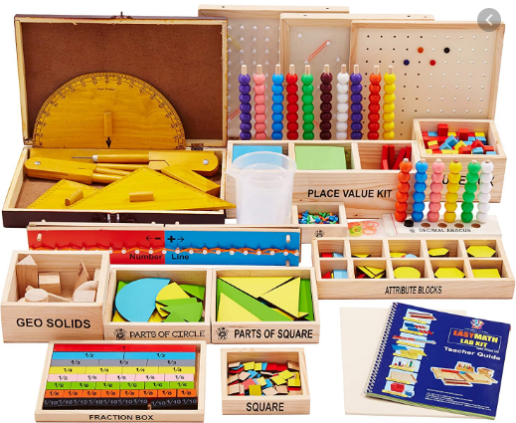
Maths Lab

Slide 37
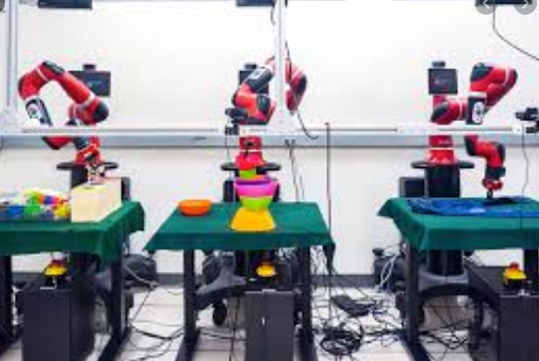
ROBOTICS LAB

Slide 38
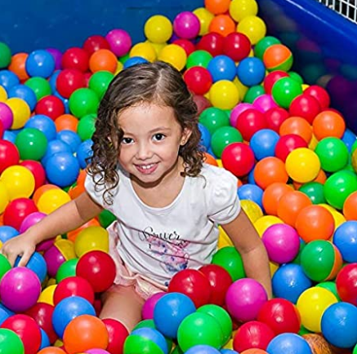
Ball pool

Slide 39

Art & Craft

Slide 40

Entire campus is under CCTV surveillance

Slide 41
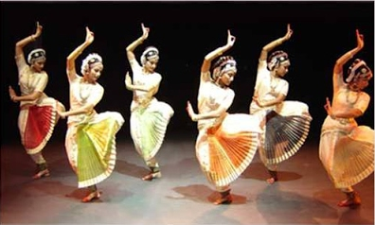
Dance and Music

Slide 42

YOGA AND FITNESS

Slide 43
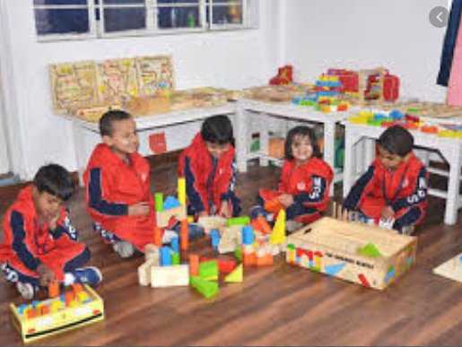
Montessori lab

Slide 44
Thank you

